Slide 1



Cyber Offense and Defense
HTTP request smuggling
Group 1
Main References
https://portswigger.net/web-security/request-smuggling#what-is-http-request-smuggling

Slide 2
How to prevent HTTP request smuggling vulnerabilities
Use HTTP/2 end to end and disable HTTP downgrading if possible. HTTP/2 uses a robust mechanism for determining the length of requests and, when used end to end, is inherently protected against request smuggling.
Make the front-end server normalize ambiguous requests and make the back-end server reject any that are still ambiguous, closing the TCP connection in the process.
Never assume that requests won't have a body. This is the fundamental cause of both CL.0 and client-side desync vulnerabilities.
Default to discarding the connection if server-level exceptions are triggered when handling requests.
If you route traffic through a forward proxy, ensure that upstream HTTP/2 is enabled if possible.

Slide 3

How to prevent HTTP request smuggling vulnerabilities
HTTP request smuggling vulnerabilities arise in situations where the front-end server and back-end server use different mechanisms for determining the boundaries between requests.

Slide 4
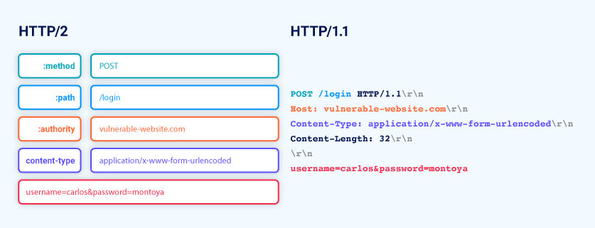
HTTP/2 downgrading
In HTTP/2 environments, the common practice of downgrading HTTP/2 requests for the back-end is also fraught with issues and enables or simplifies a number of additional attacks.
HTTP/2 downgrading, where servers convert HTTP/2 messages to HTTP/1 syntax, is common and often default in many reverse proxy services. Some services don't offer an option to disable this feature.

Slide 5
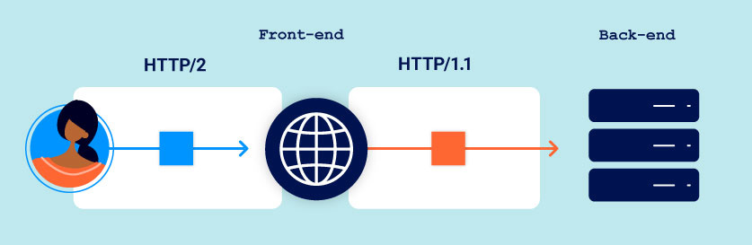
HTTP/2 downgrading
Web servers supporting HTTP/2 often convert incoming HTTP/2 requests into HTTP/1 format to communicate with legacy back-end systems that only understand HTTP/1.
When an HTTP/1 back-end responds, the front-end server translates it into an HTTP/2 response for the client, as both protocols represent the same information differently.
HTTP/2 downgrading to HTTP/1 can lead to request smuggling due to its three different length specification methods, exploiting mismatches and vulnerabilities not present in end-to-end HTTP/2 usage.

Slide 6
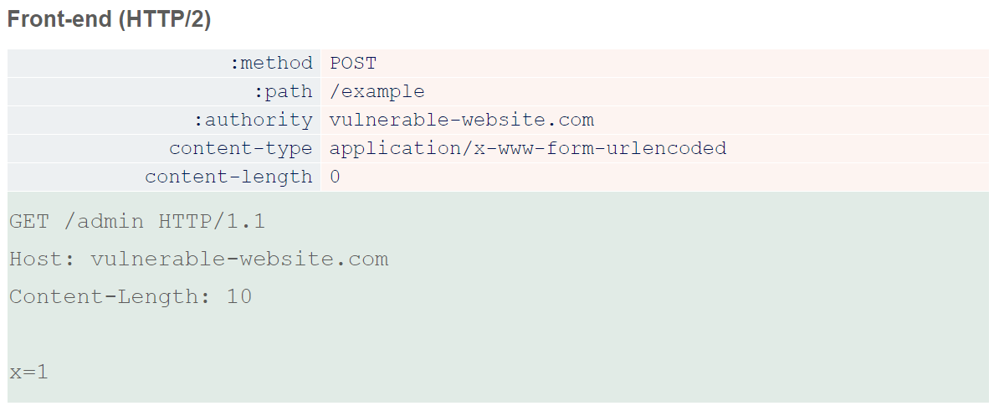
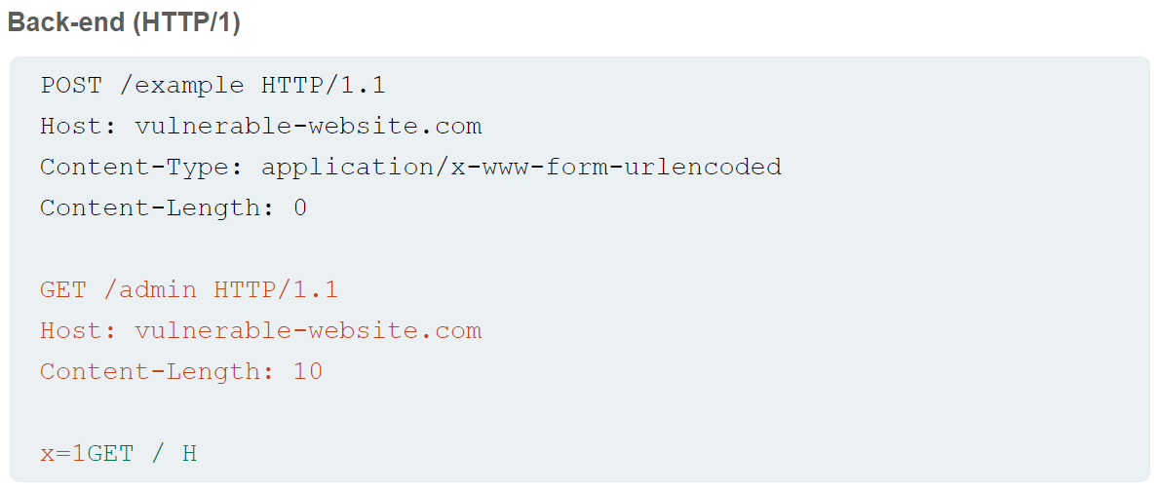
H2.CL vulnerabilities
During HTTP/2 to HTTP/1 downgrading, front-end servers may add an HTTP/1 Content-Length header based on HTTP/2's length mechanism. If HTTP/2 requests include their own content-length header, some servers reuse this value in the downgraded HTTP/1 request.
The HTTP/2 spec requires matching content-length headers with its built-in length, but improper validation before downgrading can lead to request smuggling. Injecting a misleading content-length header can cause a desync, as the front-end uses HTTP/2 length, while the HTTP/1 back-end relies on the derived Content-Length, leading to potential security vulnerabilities.

